Slide 1

Hoops IQ (NBA Trivia Quiz)
Working Quiz Draft
2. Slide 2
Answer Sheet Draft
3. Slide 3
By: Jay palmer
Test your NBA Hoops IQ!
https://github.com/ksu-is/Hoop-IQ

Slide 2
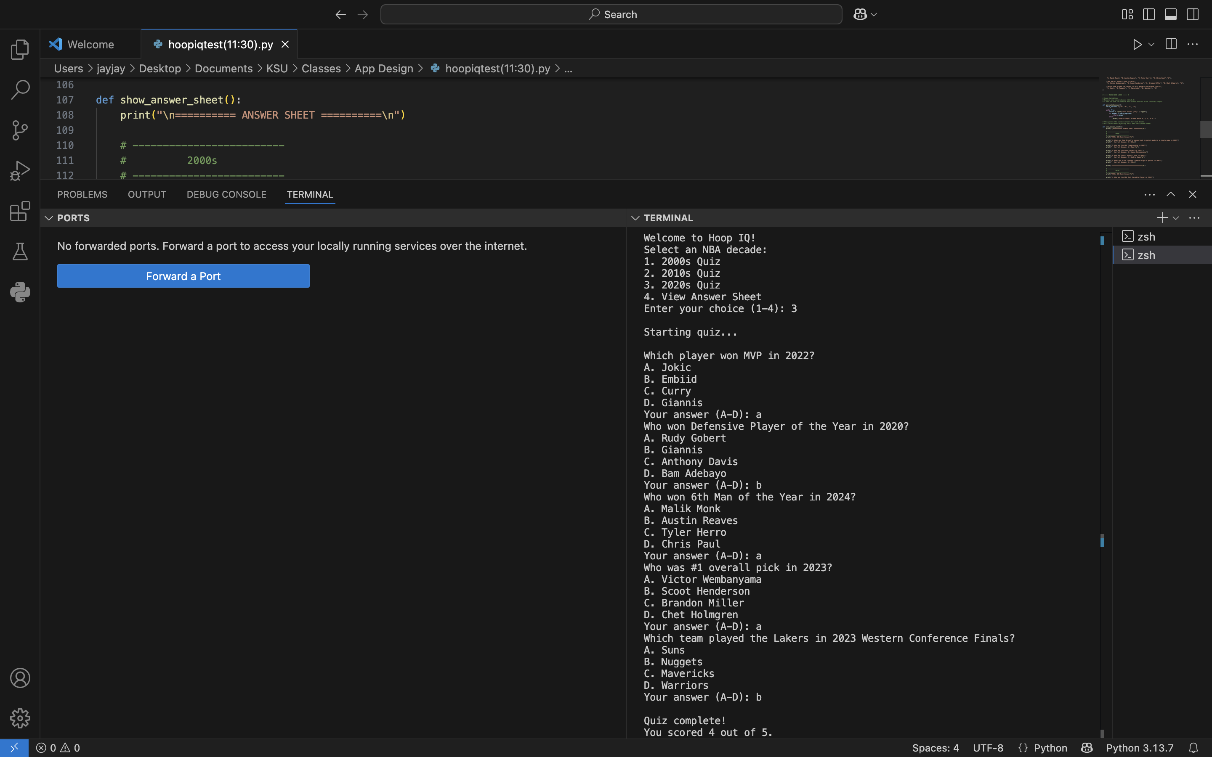
Welcome to Hoop IQ!

Slide 3
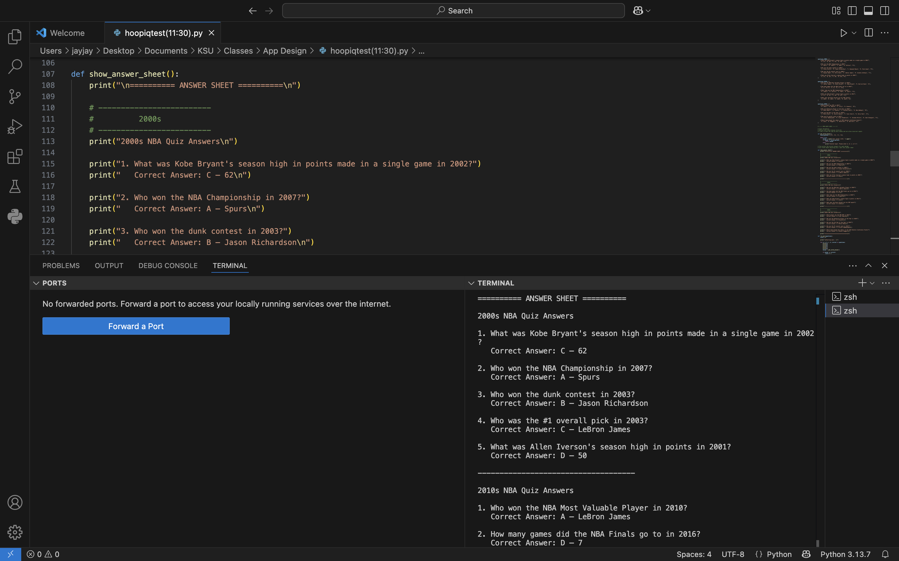
See here a answer sheet draft!
*Fun Fact* Accessible at start of quiz!

